Slide 1


Exploring the Synergy of React Native and Stream SDK
BY Cliff Gor

Slide 2

Who am i
My Name is Cliff Gor
A Software Developer
You can follow me on
Twitter – Cliffgor_
Linked In- https://www.linkedin.com/in/cliff-gor/

Slide 3
What is Stream SDK
The #1 Chat API for Custom Messaging Apps.
Build real-time chat messaging in less time. Rapidly ship in-app messaging with our highly reliable chat infrastructure and feature-rich SDKs. Improve your overall in-app conversion, engagement, and retention.

Slide 4
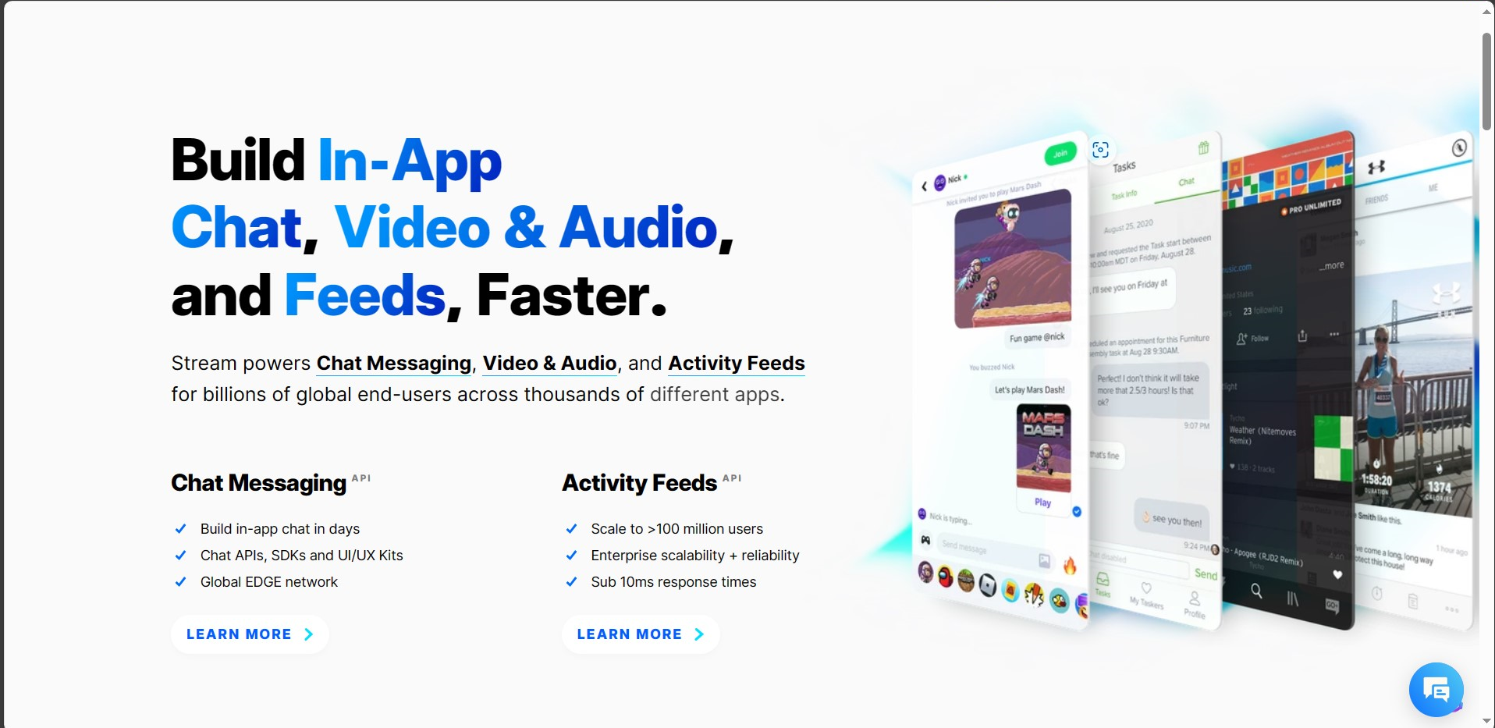

Slide 5
Benefits of Using React Native with StreamSDK
Cross-Platform Development: React Native allows you to write code once and deploy it on both iOS and Android platforms. When combined with Stream SDK, you can create real-time chat and activity feed functionality that works seamlessly across both major mobile platforms, reducing development time and effort.
Reusability: React Native promotes the use of reusable components. When you integrate Stream SDK, you can create custom chat and activity feed components that can be reused throughout your app, maintaining a consistent look and feel.

Slide 6
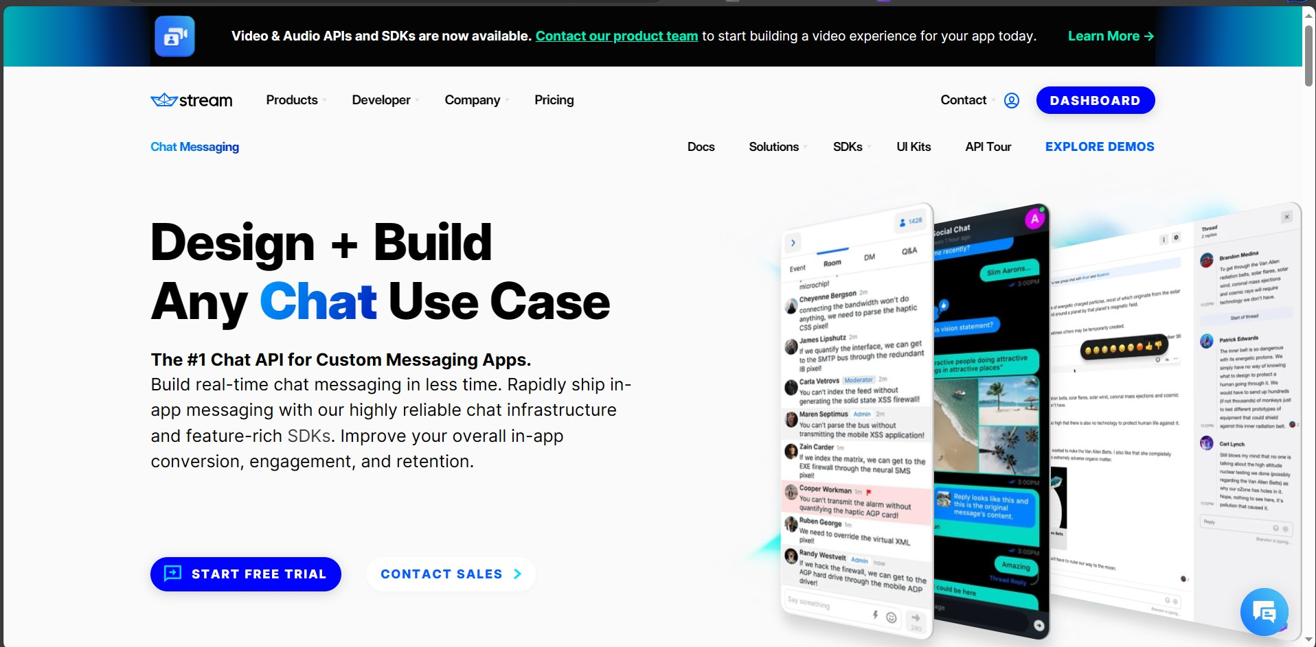
Let’s Build Our Chat

Slide 7
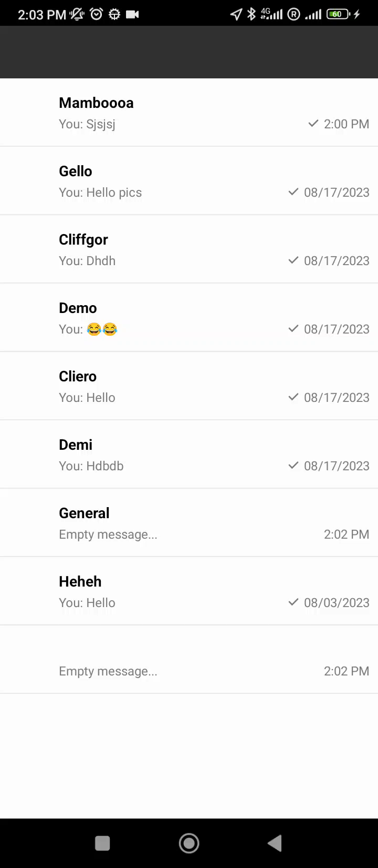
Demo

Slide 8
Usecases

Slide 9
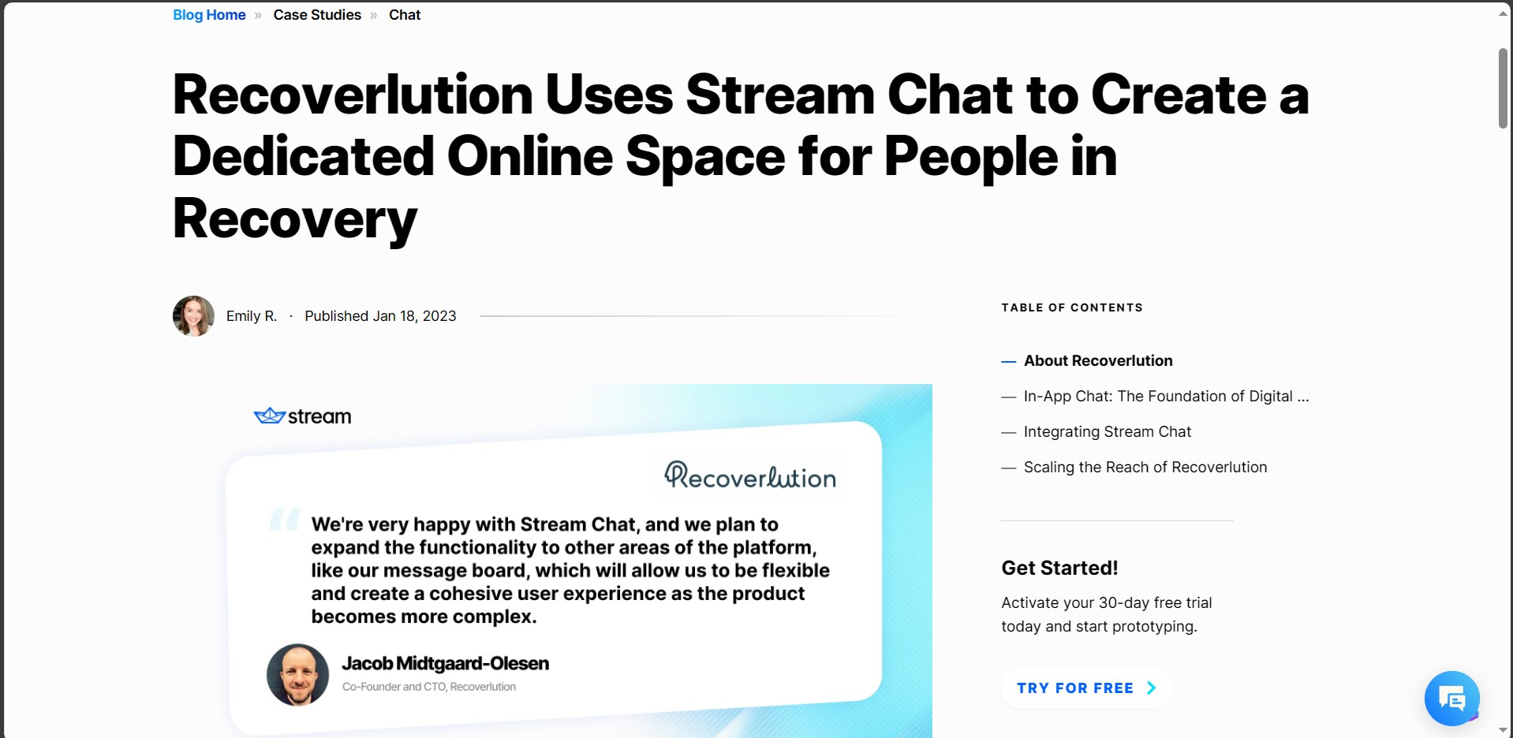

Slide 10


Thank You
Download Here

